Slide 1
Machine Learning Logistic Regression for Sentiment Analysis
Abraham Skandera
Software Development Intern

Slide 2
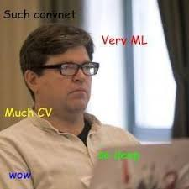
Materials
Anything you see today can be found at my personal github:
github.com/askandera
Feel free to interrupt me if you have ANY questions!
(source)

Slide 3
Machine Learning
A field of study that give computers the ability to learn without being explicitly programmed
Very useful in real world applications
Often impractical for humans to explicitly tell a computer what to do
Already a very large field
Number of ml papers posted on ArXiv keeps pace with Moore’s Law

Slide 4
What Are Some Problems ML Can Solve?
Classification
Spam Detection
Fraud Detection
Predictive Maintenance
Simulation
Quality Enhancement
Sentiment Analysis
Encoding
Language Translation
Threat Analysis
So much more…

Slide 5

What Are Some Overarching Barriers?
Data
Methods require large amounts of heavily processed data
Compute Power
Models are very computationally expensive

Slide 6


Types of Machine Learning
Supervised Learning
Classic labeled data
Unsupervised Learning
No labels
Semi-supervised Learning
Some labels
Reinforcement Learning
Learns from actions

Slide 7
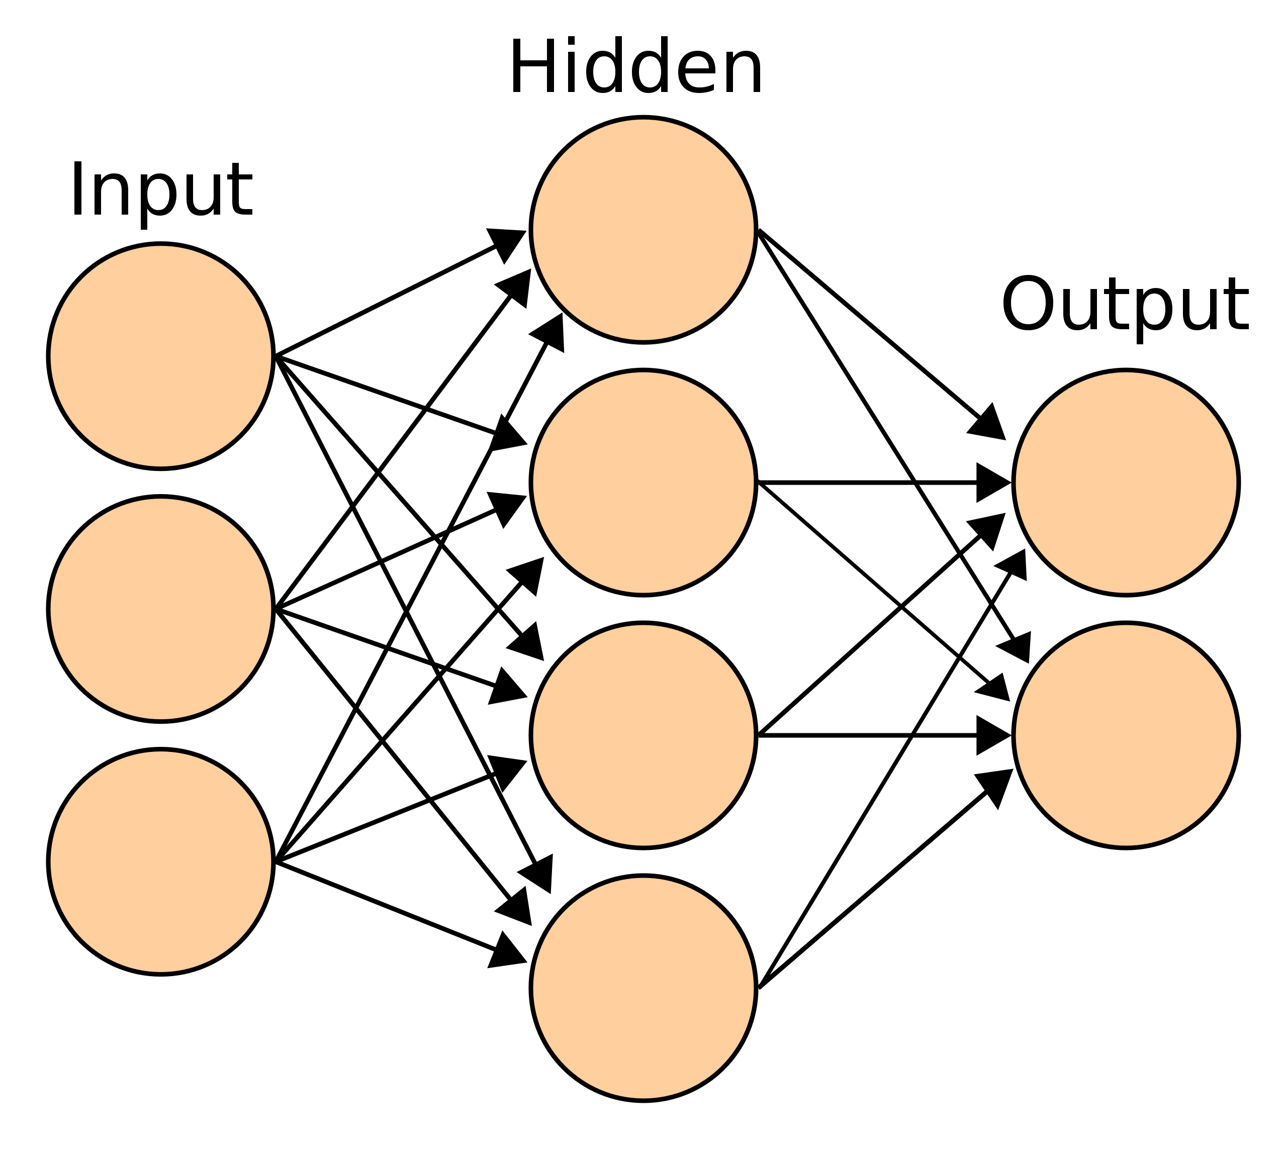
Common Supervised Learning Algorithms
Nearest Neighbor
Naive Bayes
Decision Trees
Linear Regression
Logistic Regression
Support Vector Machines
Neural Networks
(source)

Slide 8
IMDB Movie Reviews Dataset
50,000 reviews split evenly into test an train sets
This is a labeled dataset(each review has a rating associated with it)
Problem:
Given a review, can we classify it as good or bad?

Slide 9
Binary Classification Problem
Two choices
True/False, black/white, happy/sad, Heads/Tails
NOT a range of values
In the case of the reviews, good or bad

Slide 10
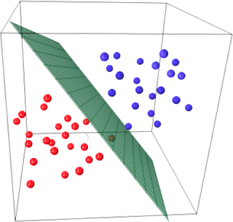
Logistic and Linear Regression
Key idea:
Represent data as points in an n-dimensional space
Find a plane or line or that separates the points in the best way possible
How this plane is found
How this data is organized

Slide 11
Linear Regression
Maximize space between a set of point and a surface in space
Usually add a regularization term
Very susceptible to outliers

Slide 12
Logistic Regression
Maximize the sum of a function applied to a set of points in space
Usually add a regularization term
Relies on the Sigmoid function

Slide 13
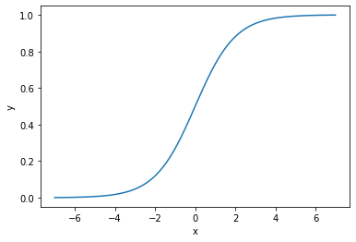
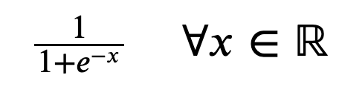
Logistic Regression and Sigmoid
Relies on the Logistic Function(aka sigmoid)

Slide 14
Pros and Cons
Advantages:
Computationally efficient
Easy to use
Well documented and understood
Disadvantages:
Can struggle with noise
Overfitting
Bias
Non-Convergence

Slide 15
Pros and Cons
Disadvantages:
Because it relies on feature vectors it can struggle with noise
Can solve this by cleaning data
Overfitting
Get more data
Regularization
Bias
Classic case is a rare disease
Upsample or Downsample data
Non-Convergence
Clean data--check for highly correlated pts

Slide 16
Back to Reviews
How might we go about separating them?
Vectorize words
Problems with using linear regression
Potentially huge disparity in word representation
Logistic Regression!

Slide 17
